Slide 1

Impact of data dimensions on difficulty in learning for Deep Neural Networks (Fintech)
Prepared by: Shearman Chua

Slide 2
Objective
Find a full order or partial order of financial technical indicators in terms of their magnitudes of impacts on difficulty of learning
Definition of quantities in terms of the significance for each data dimension in terms impact of difficulty in learning

Slide 3
Initial Technical Indicators
Last 15 days Closing Price of Stock
Moving Averages and Momentum indicators
Moving Averages | Momentum Indicators
SMA (Simple Moving Average) | CCI (Commodity Channel Index)
EMA (Exponential Moving Average) | CMO (Chande Momentum Oscillator)
TEMA (Triple Exponential Moving Average) | DMI (Directional Movement Index)
KAMA (Kaufman's Adaptive Moving Average) | MOM (Momentum Indicator)
WMA (Weighted Moving Average) | ROC (Rate of Change)
 | RSI (Relative Strength Index)
 | Stochastic (Stochastic Oscillator)
 | WILLR (Williams %R)

Slide 4
Deep Neural Networks Used
Find impacts on difficulty of learning of Financial Indicators for 2 Deep Neural Network Architecture
LSTM (Long short-term memory)
CNN (Convolutional Neural Network)

Slide 5
LSTM (Long short-term memory) Parameters
1000 Training Epochs
Batch Size : 64
Layers:
LSTM Layer (200 Neurons, kernel_regularizer=l2(1e-3), activation = ‘Relu’, Batch Normalization)
LSTM Layer (200 Neurons, kernel_regularizer=l2(1e-3), activation = ‘Relu’, Batch Normalization)
Dense Layer (100 Neurons, kernel_regularizer=l2(1e-3), activation = ‘Relu’, Batch Normalization)
Dense Layer (3 Neurons, activation = ‘softmax’)
Adam Optimizer (Learning rate = 1e-5)

Slide 6
CNN (Convolutional Neural Network) Parameters
1000 Training Epochs
Batch Size : 64
Layers:
CNN Layer (16 Channels, 3x3 filter, kernel_regularizer=l2(1e-4), activation = ‘Relu’, Batch Normalization)
CNN Layer (32 Channels, 3x3 filter, kernel_regularizer=l2(1e-4), activation = ‘Relu’, Batch Normalization)
Max Pooling Layer (2x2 filter)
Dense Layer (128 Neurons, kernel_regularizer=l2(1e-4), activation = ‘Relu’, Batch Normalization)
Dense Layer (3 Neurons, activation = ‘softmax’)
Adam Optimizer (Learning Rate = 1e-5)

Slide 7
Quantifying significance for each indicator in terms impact of difficulty in learning
How to quantify?
Final Epoch Validation Loss, Validation Accuracy
Learning rate for model accuracy (percent per epoch)
Learning rate for model 10 epochs moving average accuracy (percent per epoch)
Rate of model accuracy learning jitter
Rate of model loss learning jitter

Slide 8
Learning Rate Formula (Accuracy)
Learning rate = sum (current highest accuracy – previous highest accuracy) / (number of training epochs)
sum (current highest accuracy – previous highest accuracy) -> If current epoch’s accuracy higher than previous highest accuracy, add the difference of the 2 accuracies to the total sum
As for most of the models, there is a drop of accuracy to the absolute minima for the first 20 epochs, we take the accuracies for the last 980 epochs

Slide 9
Learning Rate Formula (Loss)
Learning rate = sum (previous lowest loss – current lowest loss) / (number of training epochs)
sum (previous lowest loss – current lowest loss) -> If current epoch’s loss lower than previous lowest accuracy, add the difference of the 2 losses to the total sum
As for most of the models, there is a sudden drop of loss for the first 20 epochs, we take the losses for the last 980 epochs

Slide 10
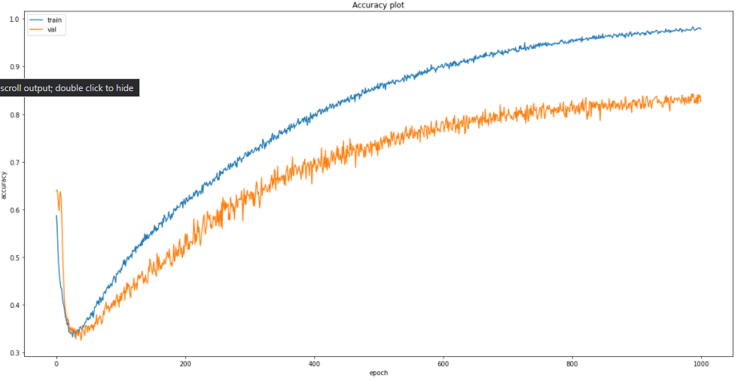
Learning jitter
During training, the deep learning models experience learning “jitters”, which are minor drops of accuracies before going back up again ( as seen in the graph below)

Slide 11
Learning jitter
Therefore, we want to observe if removing any technical indicators results in more learning ‘jitter’
The rate of learning jitter (%) is given by: learning jitter = (count of minor accuracy drops / number of training epochs) * 100
This gives the percentage of training duration where learning jitter occurs

Slide 12
Learning jitter
Due to the presence of learning jitter, we also find the 10 epochs moving average for both accuracy and loss
This will give us a more “smoothed” out learning curve
We also find the learning rate for the 10 epochs moving average for both accuracy and loss

Slide 13
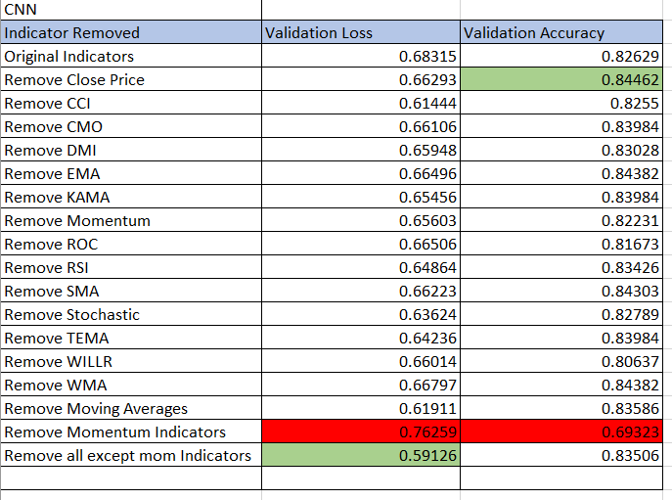
Results (CNN)
Validation Loss & Accuracies

Slide 14
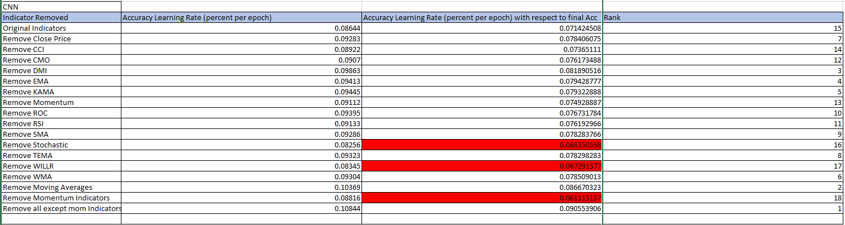
Results (CNN)
Learning Rates
For CNN, momentum related indicators are more important features for learning

Slide 15
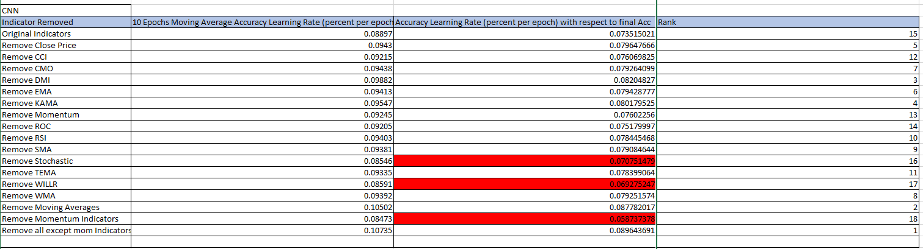
Results (CNN)
Learning Rates ( 10 Epochs Moving Average)
For CNN, momentum related indicators are more important features for learning

Slide 16
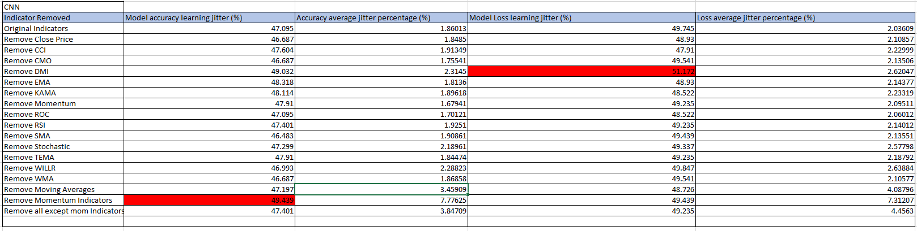
Learning Jitter
Results are not very conclusive. However, removing momentum related indicators resulted in the most learning jitter and the highest average jitter percentage deviation

Slide 17
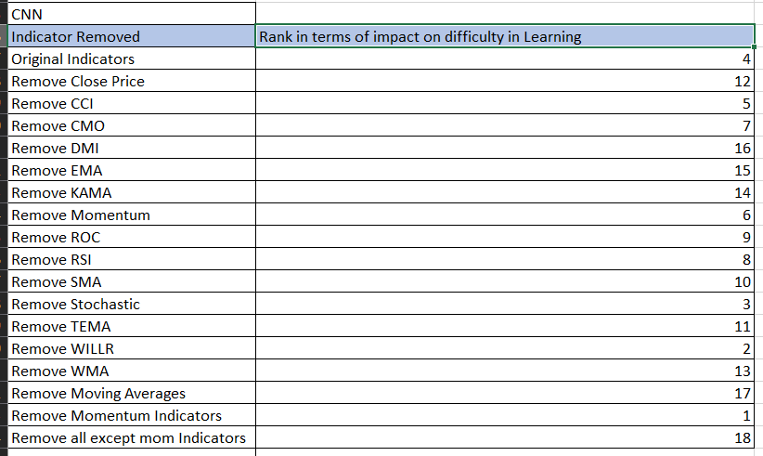
Impact on Learning Difficulty
For the CNN models, removing momentum related indicators will impact the learning of the models the most
Moving averages and closing prices are not significant to the learning in CNN models

Slide 18
Conclusions on the impact of technical indicators on the difficulty of learning in CNN
Momentum indicators have more significant impact
Moving Averages and Closing Prices does not help much in learning for CNN models
The model that performed best is the model using only momentum related indicators
Removing more indicators causes more learning jitter

Slide 19
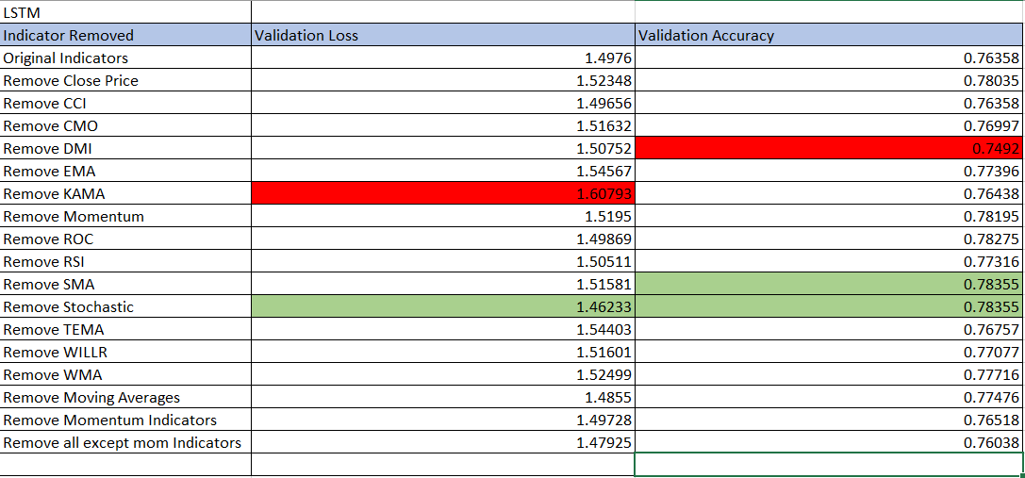
Results (LSTM)
Validation Loss & Accuracies

Slide 20
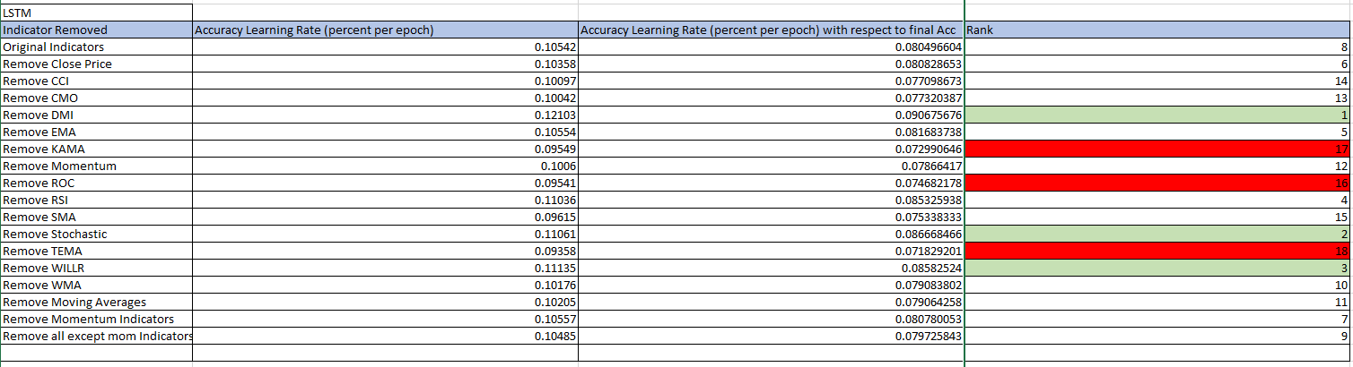
Results (LSTM)
Learning Rates
For LSTM, the results are not as conclusive as the CNN results where we are not able to determine if momentum related indicators or moving average related indicators impact the learning of the models more

Slide 21
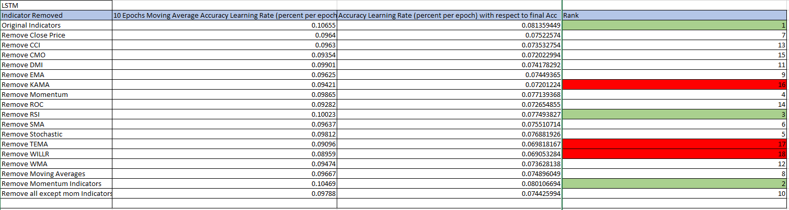
Results (LSTM)
Learning Rates (10 epochs moving average)
For LSTM, removing TEMA(moving average) and WILLR (momentum) indicators impact the learning of the models the most
Using all indicators provides the best learning results

Slide 22
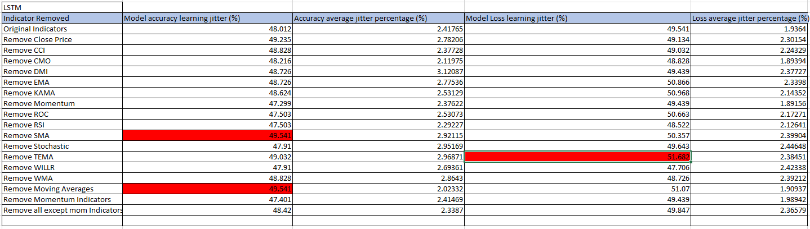
Learning Jitter
Results are not very conclusive. However, removing moving average related indicators resulted in the more learning jitter generally as compared to momentum related indicators

Slide 23
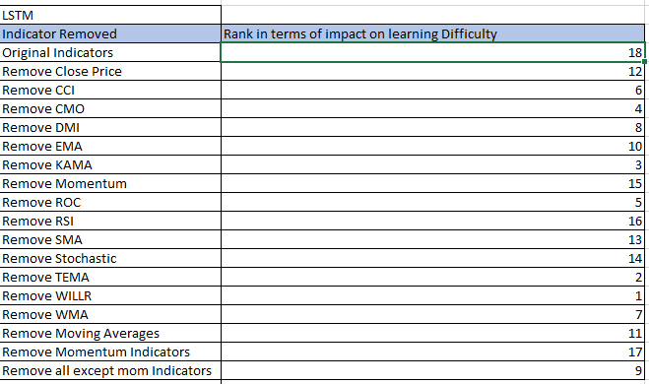
Impact on Learning Difficulty
For the LSTM models, the results were more inconclusive. Example, from the table above, we can see that the model with learning affected the most is the model without WILLR indicator which is momentum related
However, when we remove more momentum indicators, the learning affected is the second least affect, with the least affected model being the model with all indicators

Slide 24
Conclusions on the impact of technical indicators on the difficulty of learning in LSTM
Compared to the CNN models, we were unable to determine which indicators are more significant to the impact on the difficulty of learning for LSTM models
The model with the best learning rate is the model with all the indicators included

Slide 25
Overall Conclusions
Overall, the CNN models performed better than the LSTM models in terms of validation loss and validation accuracy
The CNN model with the highest learning rate(0.0896) has a higher learning rate than that of the LSTM model with the highest learning rate (0.0814)

Slide 26
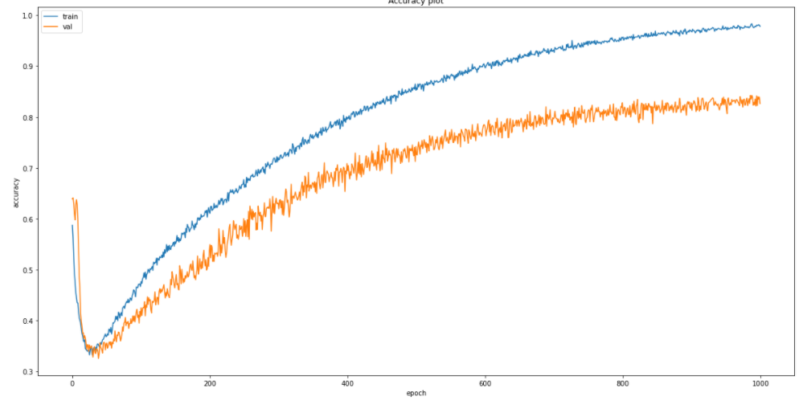
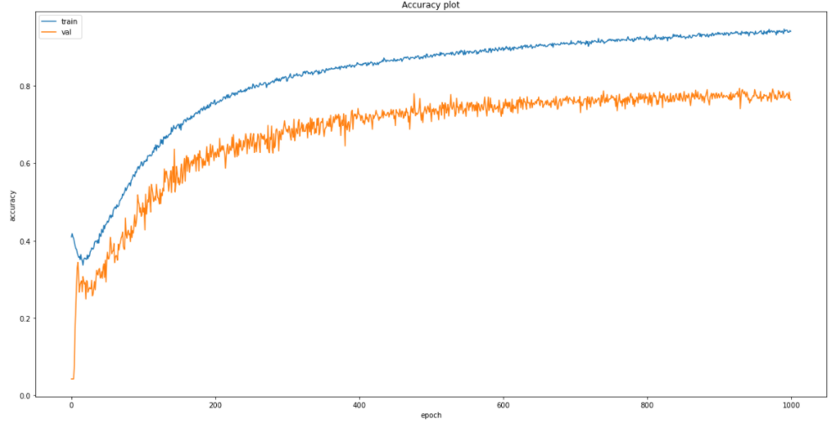
Overall Conclusions
LSTM models learning stagnates faster than CNN models
CNN Model
LSTM Model

